Slide 1
(insert your company logo)
Business Continuity Planning

Slide 2
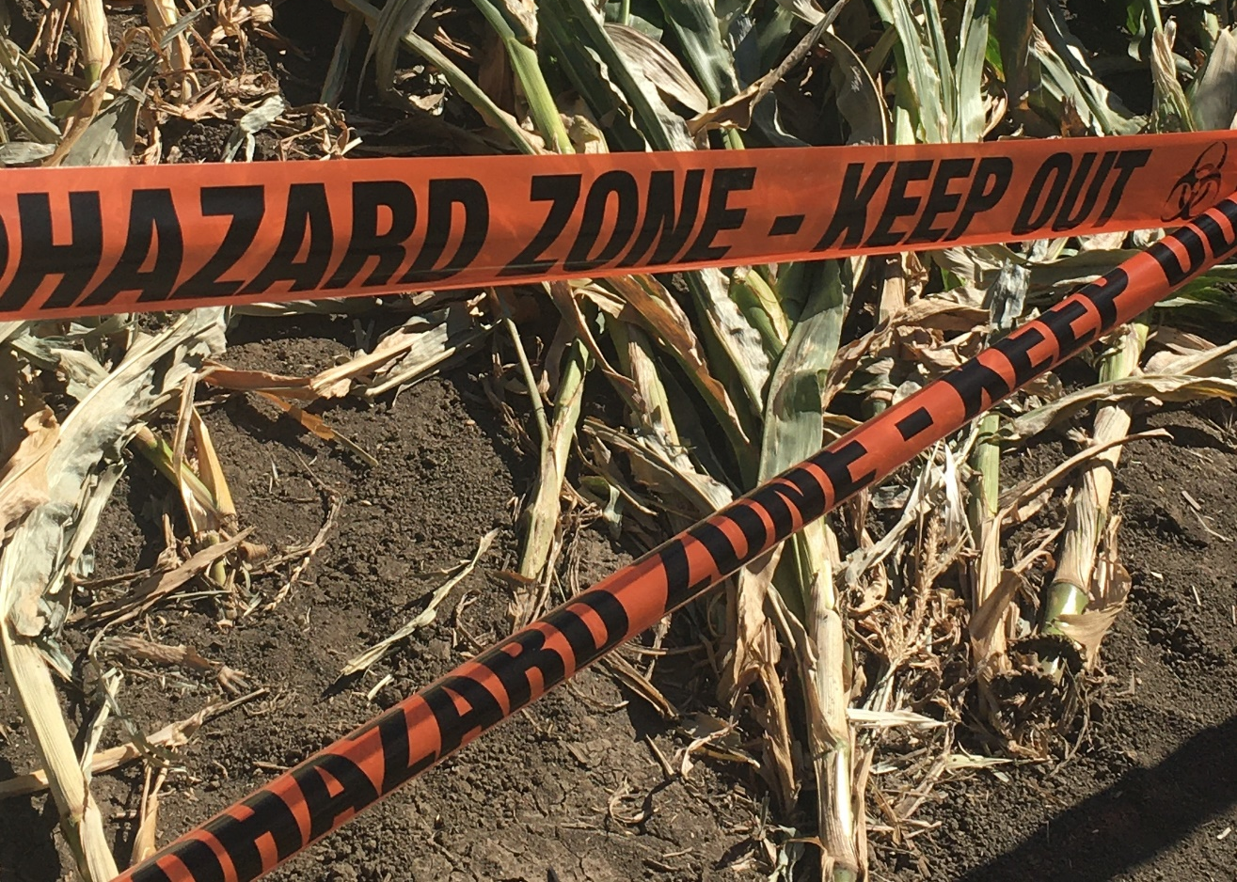



Chemical leak
Fire outbreak
Crises can come in all forms
Power outage
Terrorism & Security
Royalty-free images by Pexels and Unsplash

Slide 3
S/N | Description
1 | Objective of policy
2 | About DORSCON
3 | How DORSCON affects work
4 | Working from home
5 | Staff in specific scenarios, obligation to notify
6 | Data protection practices for working from home
7 | Personal hygiene awareness
8 | Appendix A: Organization Chart

Slide 4
Objective of policy
As part of our endeavor to be an effective organization, a responsible member of the business community and a caring stakeholder to the society, we undertake Business Continuity Planning (BCP) in preparation for times of crisis.
BCP is to create a system of prevention and recovery from potential threats to us. The policy ensures that our staff and assets are protected and are able to function quickly in the event of a crisis. Ultimately, the goal is to enable operations to carry on before and during execution of crisis recovery.
Our resistance to failure is the ability to withstand changes in our environment and still function. Also termed as resilience, it is our capability to either endure environmental changes without having to permanently adapt, or to adapt a new way of working that better suits the new environmental conditions.

Slide 5
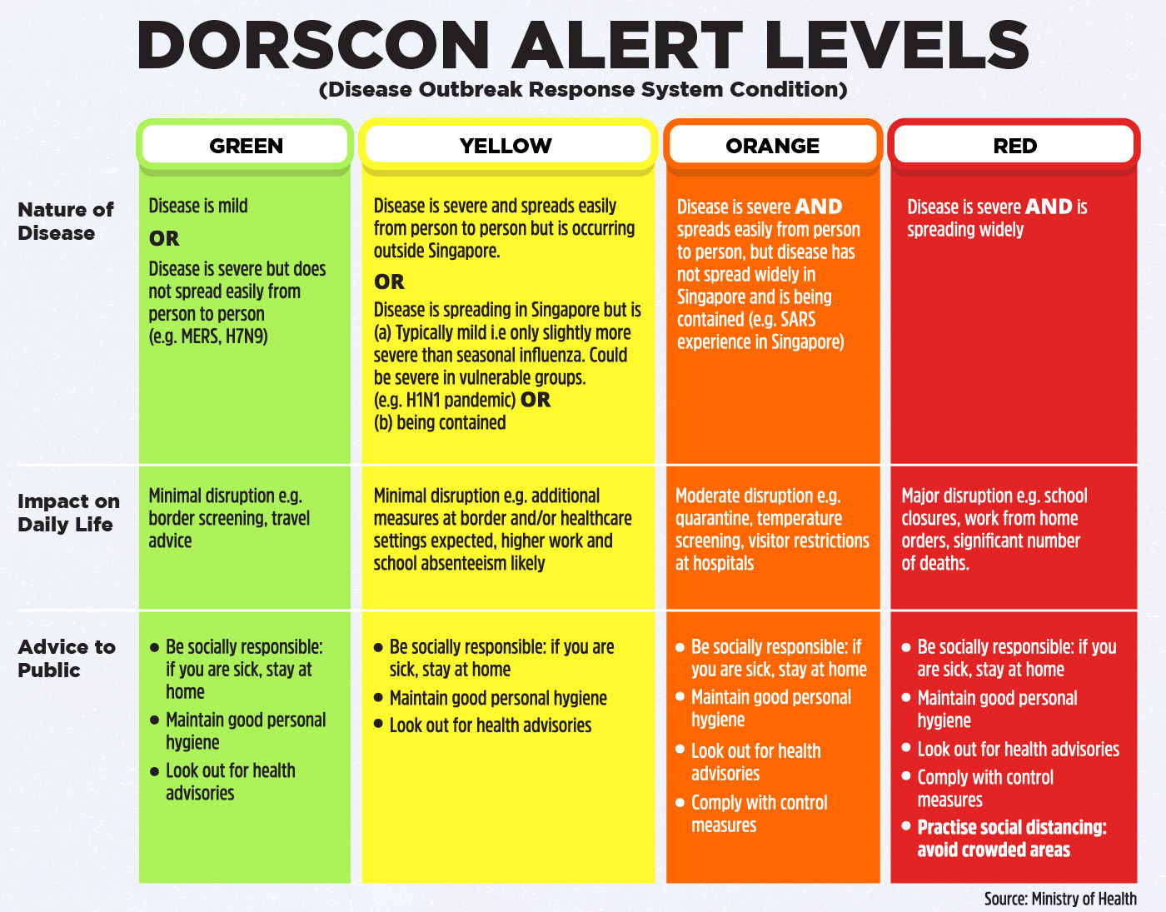
About DORSCON
The Disease Outbreak Response System Condition (DORSCON) is a colour-coded framework that shows the current disease situation, providing all stakeholders general guidelines on what needs to be done to prevent and reduce the impact of infections.
DORSCON takes into account:
The current disease situation overseas
How transmissible the disease is
How likely it is to arrive in (insert your country’s name)
What impact it may have on (insert your country’s name)’s community
There are 4 statuses (Green, Yellow, Orange and Red) depending on the severity and spread of the disease. For each status, it details the impact on the community and advice to the public.
For the latest status, all stakeholders are advised to check the Ministry Of Health (MOH) website.

Slide 6
How DORSCON affects work
In relation to changes in disease situation, all staff are to follow the following guideline,
Stage | Disease situation | Our practices
Green | Disease is mild. OR Disease is severe but does not spread easily from person to person. | 1) Observe basic hygiene practices 2) Availability of hand sanitizers and masks (if necessary) 3) Look out for health advisories 4) Sick staff to seek medical attention
Yellow | Disease is severe and spreads easily from person to person but is occurring outside (insert your country’s name). OR Disease is spreading in (insert your country’s name) but is (a) typically mild, or (b) being contained. | All the above, plus 1) 14 days Leave Of Absence for those returning from affected countries 2) Enhanced office cleaning 3) Temperature checks 4) Travel declaration
Orange | Disease is severe. AND Disease spreads easily from person to person, but disease has not spread widely in (insert your country’s name) and is being contained. | All the above, plus 1) Cancel all non-essential partner meetings 2) Work from home (Team A & B to rotate weekly)
Red | Disease is severe. AND Disease is spreading widely. | All the above, plus 1) Cancel all non-essential client meetings 2) Work from home (Team A at home, Team B in office)

Slide 7
Working from home
We care for our staffs’ health and well-being. Upon the transition into DORSCON orange, work-from-home arrangements will be implemented. This is to minimize health risk to all staff and also to minimize the risk of the office becoming a node of transmission.
All staffs are to maintain work responsibility even while working from home. The following requirements are set in place to ensure proper functioning across various locations:
Daily email notification must be sent to the respective HODs, by the end of day, to document what has been done.
Contactable via mobile phone, email and Hangout.
Call transferring to be assisted by team in office.

Slide 8
Working from home
HODs are to split their team (inclusive of part time staffs and interns) into Team A and Team B, keeping in mind the objective to balance work functions and responsibilities so as to ensure business continuity and client needs. HODs are to submit their arrangements to BCP team (insert your email address) for approval, in the following format:
Team A | Team B
(sample person’s name) | (sample person’s name)
(sample person’s name) | (sample person’s name)
(sample person’s name) | (sample person’s name)

Slide 9
*Reminder*
Working from home
Maintain good customer service, prompt follow up of queries
Maintain professional behavior towards customers and colleagues (proper attire when doing video-conference)
Keep your HOD updated daily (email) of what you have done for the day

Slide 10
Staff in specific scenarios, obligation to notify
We are aware that there may be certain demographics of staff who may require special care:
Working parents
Pregnant – With proof of pregnancy
Have underlying medical conditions and other exceptional cases – Please submit the information to your relevant HODs for management approval
Staff in these demographics will be prioritized in BCP planning for work-from-home arrangements.

Slide 11
Staff in specific scenarios, obligation to notify
For staff within the following two demographics, they have the obligation to notify their relevant HODs immediately:
Have potential contact with diagnosed individuals
Have involvement with contact tracing or other similar regulatory checks
Staff in these demographics represent higher risks from health perspective and will need to inform their relevant HODs, so as to enable us to assess and make special arrangements where needed.
For staff who are on Ministry Of Manpower (MOM) mandated 14 days Stay Home Notice (SHN), they are to strictly comply with the advisory. MOM will not hesitate to revoke the staff’s work pass and withdraw our work pass privileges against errant behaviors.

Slide 12
Data protection practices for working from home
Staff are to be aware of the main causes of security incidents and data breaches:
Hacking or other unauthorized access of databases.
Malware or hostile programs such as computer viruses and spyware.
Social engineering, such as phishing scams and the circulation of malware-laden email attachments.
Loss or theft of electronic devices or portable storage devices containing personal data.
Unintended disclosure of personal data to another individual other than the intended recipient.

Slide 13
Data protection practices for working from home
All staff are encouraged to continue with the same security and privacy standards in their handling of personal data at home, as they would in office. With reference to Personal Data Protection Commission (PDPC)’s guidelines, good practices are such as:
Sending of personal data
    Ensure sending destination information (eg mailing address, email address or fax number) is correct and matches that of the intended recipient prior to sending.
    Ensure personal data to be sent is correct (eg right document containing personal data, right personal data contained in the document).
    Ensure only the relevant personal data is disclosed to the recipients (eg sending only the required subset of personal data).
2) For disposal of personal data stored on physical documents in paper form
a. Bring back physical documents to office for shredding.

Slide 14
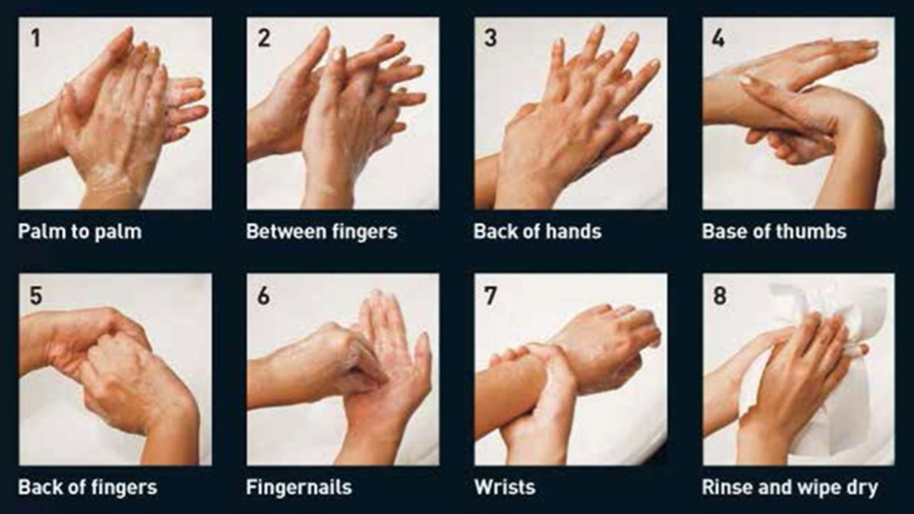
Personal hygiene awareness
As advised by Health Promotion Board (HPB), all staff are to be aware of personal hygiene practices:
Cover your mouth when coughing or sneezing
Maintain good indoor ventilation
Avoid sharing food, crockery, utensils and other personal hygiene items
Avoid physical contact such as shaking hands and avoid touching your face or rubbing your eyes
Maintain good personal hygiene, including hand washing with soap and water, or the use of alcohol-based hand rubs
Proper hand washing requires soap and water. The constant rubbing action helps soap break down the grease and dirt that carry most germs. Washing your hands for at least 15 to 30 seconds with soap and water does not just make your hands smell fresh but also reduces germ count by up to 99%
Follow these 8 simple steps to keep your hands clean:
  Palm to palm
  Between fingers
  Back of hands
  Base of thumbs
  Back of fingers
  Fingernails
  Wrists
  Rinse and wipe dry
Image by Ministry Of Health Singapore

